Slide 1
Student database management
Prepared By: Vishal.s

Slide 2
Introduction
The Student Database Management System is a desktop application developed to manage student information efficiently.
The system allows:
Secure login authentication
Adding student details
Storing records in MySQL database
Managing student data digitally
This project reduces manual paperwork and improves data management accuracy.

Slide 3
Objectives
To develop a user-friendly student management application
To store student records in a database
To implement login authentication
To connect Java application with MySQL database
To perform student data insertion operations efficiently

Slide 4
Technologies Used
Front End
Java Swing
Back End
Connectivity
JFrame
JLabel
JTextField
JButton
Development Tool
MySQL Database
JDBC (Java Database Connectivity)
IntelliJ IDEA / NetBeans

Slide 5
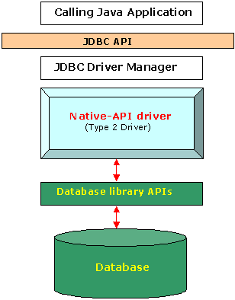
System Architecture
Working Flow
User enters login credentials
Login is validated
User enters student details
Data is sent through JDBC
MySQL stores the student information
This Photo by Unknown Author is licensed under CC BY

Slide 6
Modules of the System
1. Login Module
Verifies username and password
Provides secure access
2. Add Student Module
Accepts student details
Saves information into database
3. Database Connectivity Module
Establishes connection between Java and MySQL

Slide 7
Code Explanation
Login.java
Handles user authentication
Checks username and password
Opens AddStudent window after successful login
AddStudent.java
Collects student information
Inserts data into database using SQL query
DBConnection.java
Creates database connection using JDBC
SQL Script
Creates database and student table

Slide 8
Advantages
Easy to use interface
Fast data storage and retrieval
Reduces manual work
Improves data accuracy
Secure login system

Slide 9
Applications
Schools
Colleges
Educational Institutions
Student Record Management

Slide 10
Future Enhancement
Update and Delete student records
Search functionality
Attendance management
Report generation
Admin dashboard

Slide 11
conclusion
The Student Database Management System successfully manages student information using Java and MySQL.
The project demonstrates:
GUI development using Java Swing
Database connectivity using JDBC
Data storage using MySQL

